Slide 1
Data Explanatory Analysis

Slide 2
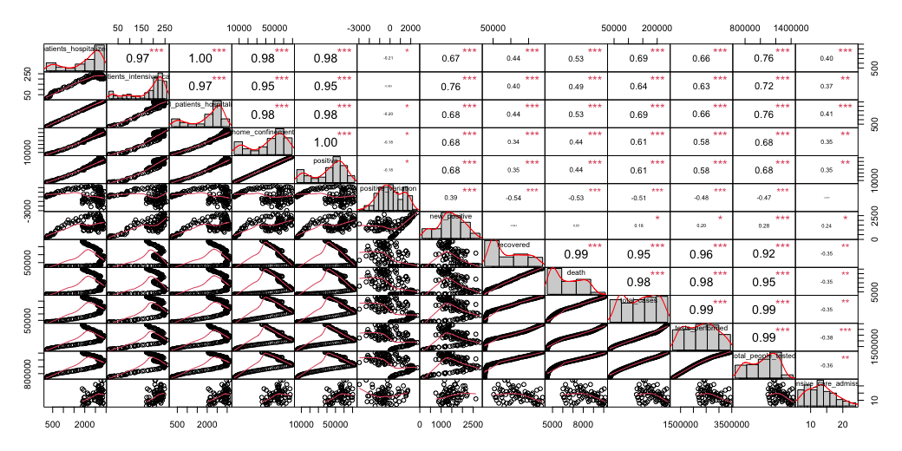
Scatter plot of response and covariates

Slide 3
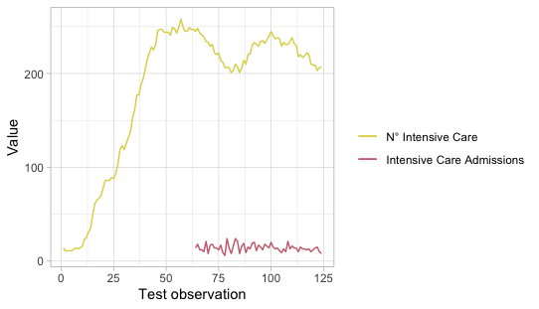
Missing values
We decided to discard the Intensive Care Admission since it presents 64 NA values. We are not able to compute the previous values for this variable.

Slide 4
Inclusion of other useful covariates
Also in this analysis we added the color of the region as a new covariant.
With 36 missing values that were dealt with by putting white as color.

Slide 5
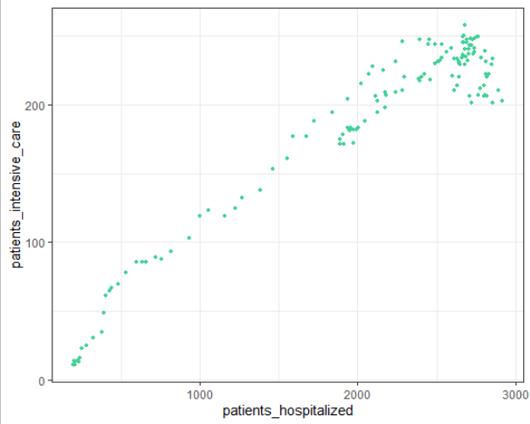
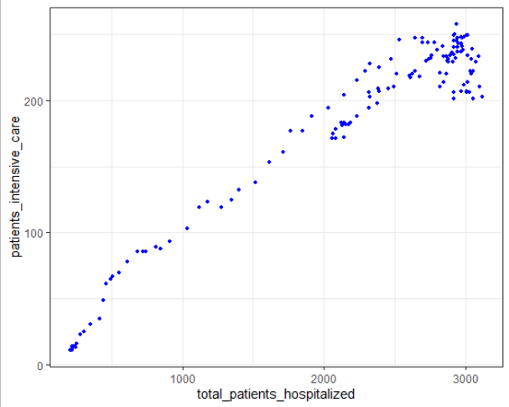
High correlation between some variables
Many variables shows high correlation among them. This will affect the models by causing high VIF, collinearity or concurvity.
As an example, the patients hospitalized and total patients hospitalized are highly correlated (0.97) as shown in the following scatter plots.

Slide 6
Pearson correlation coefficients
r is always a value between -1 and +1;
The further an r value is from zero, the stronger the relationship between the two variables.
The sign of r indicates the nature of the relationship (positive or negative)
We can use another index which is the coefficient of determination and it is given by r². It can be interpreted as the percentage of variation of the y variable that can be attributed to the variation in X.
Higher correlation means a larger portion of the variance that can be explained by the independent variables.

Slide 7
Variables | Pearson (r) | Coefficient of determination (r²)
total_patients_hospitalized | 0.9707677 | 0.94239
patients_hospitalized | 0.96577 | 0.9327117
positive | 0.953907 | 0.9099386
home_confinement | 0.9523266 | 0.9069259
total_people_tested | 0.8186488 | 0.6701859
new_positive | 0.7729051 | 0.5973823
tests_performed | 0.7650006 | 0.5852259
total_cases | 0.7399959 | 0.5475939
death | 0.5905949 | 0.3488023
recovered | 0.5032216 | 0.253232
color | - 0.3757692 | 0.1412025
positive_variation | 0.09574245 | 0.009166617

Slide 8
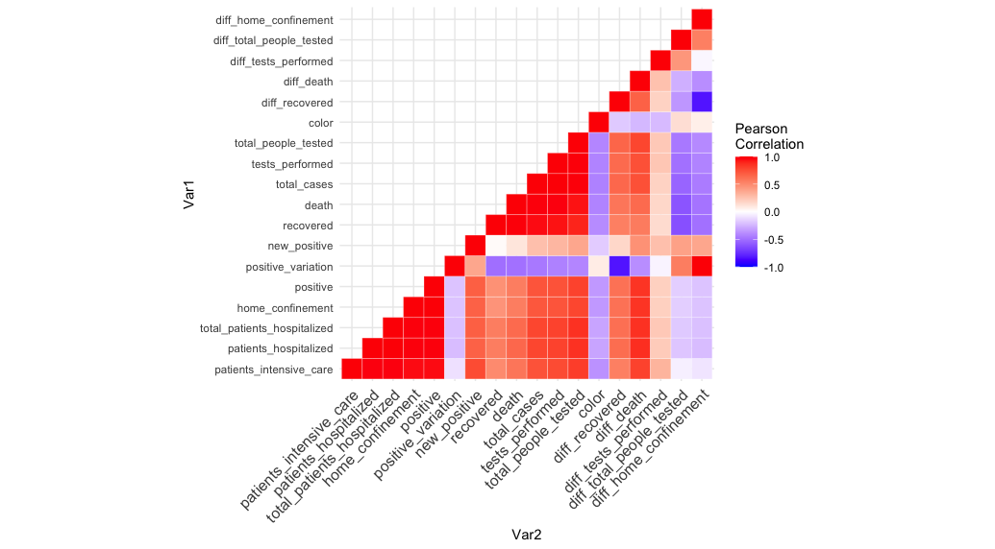

Slide 9
Correlation between variables and best fits
Examining the Pearson coefficients, we decided to only model the independent variables to test their effect on prediction.
Independent variables are those who were not a linear combination of any other variables. This will allow us to decrease collinearity and hence obtain better fits.
These independent variables are:
total_patients_hospitalized
total_test_performed
new_positives
color

